Slide 1
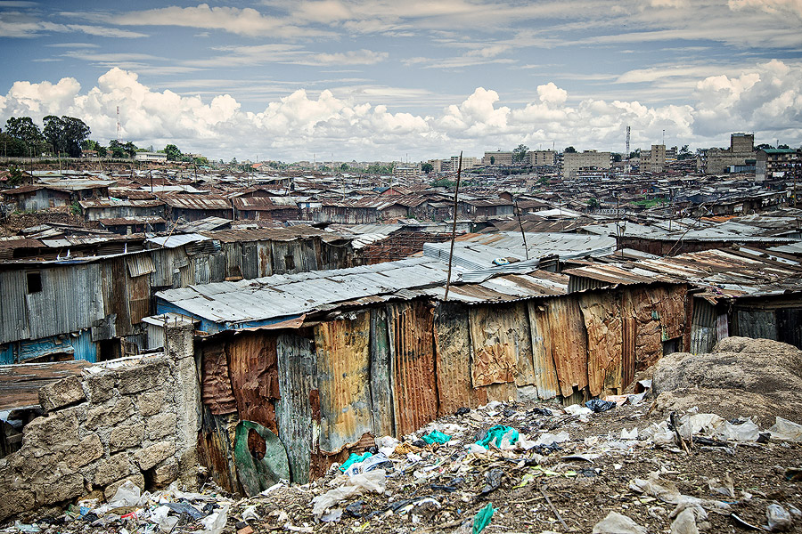
SLUMS, SQUATTERS & IRREGULAR SUBDIVISION
Department of City & regional Planning,
Lahore College for Women University, Lahore

Slide 2
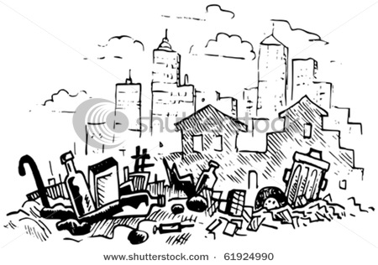
What Exactly the ‘SLUM’ is ?

Slide 3
Slum is predominantly an overcrowded area where dwelling are unfit for human habitation.
The word slum traditionally describes a neighborhood of housing that was once in good condition but has since deteriorated or been subdivided into a state of high crowding and rented out to low-income groups.

Slide 4
UN-HABITAT defines a slum household as a group of people living under the same roof in an urban area who lack one or more of the following conditions; durable housing, sufficient living area, access to clean water, access to proper sanitation and secure tenure.

Slide 5
A squatter settlement on the other hand, is an area of poor quality housing built on illegally occupied land. They are also known as shanty towns.
A third kind of settlement is an irregular subdivision, in which the legal owner subdivides the land into sub-standard plots and sells or rents them out without following all relevant building bylaws.

Slide 6
Causes that create these settlements
Rular-Urban Migration
Urbanisation
Poor house planning
Poor infrastructure, social exclusion and economic stagnation
Poverty
Politics
Social Conflicts
Natural Disasters

Slide 9
Countermeasures
Slum removal
Slum relocation
Slum upgrading
Urban infrastructure development and public housing

Slide 10
Biggest Slums In World
1. Khayeltisha, Cape Town, South Africa
2. Kibera, Nairobi, Kenya
3. Dharavi, Mumbai, India
4. Orangi Town, Karachi, Pakistan
5. Neza-Chalco-Itza, Mexico City, Mexico

